Slide 1
What is the FSHN GSA?
The FSHN Graduate Student Association (GSA) is the organization for all FSHN Department grad students. If you are a grad student in our department, you are automatically a member!
What are our goals?
BUILD COMMUNITY
HELP STUDENTS BE SUCCESSFUL
MAKE GRAD SCHOOL FUN!

Slide 2
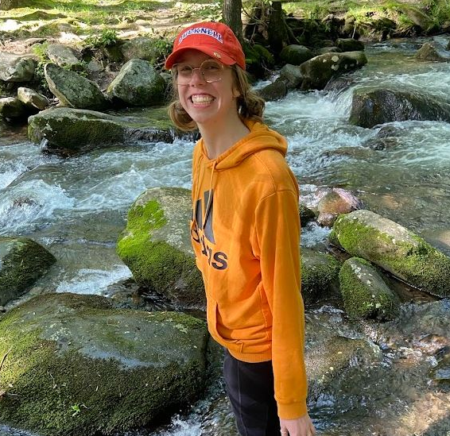
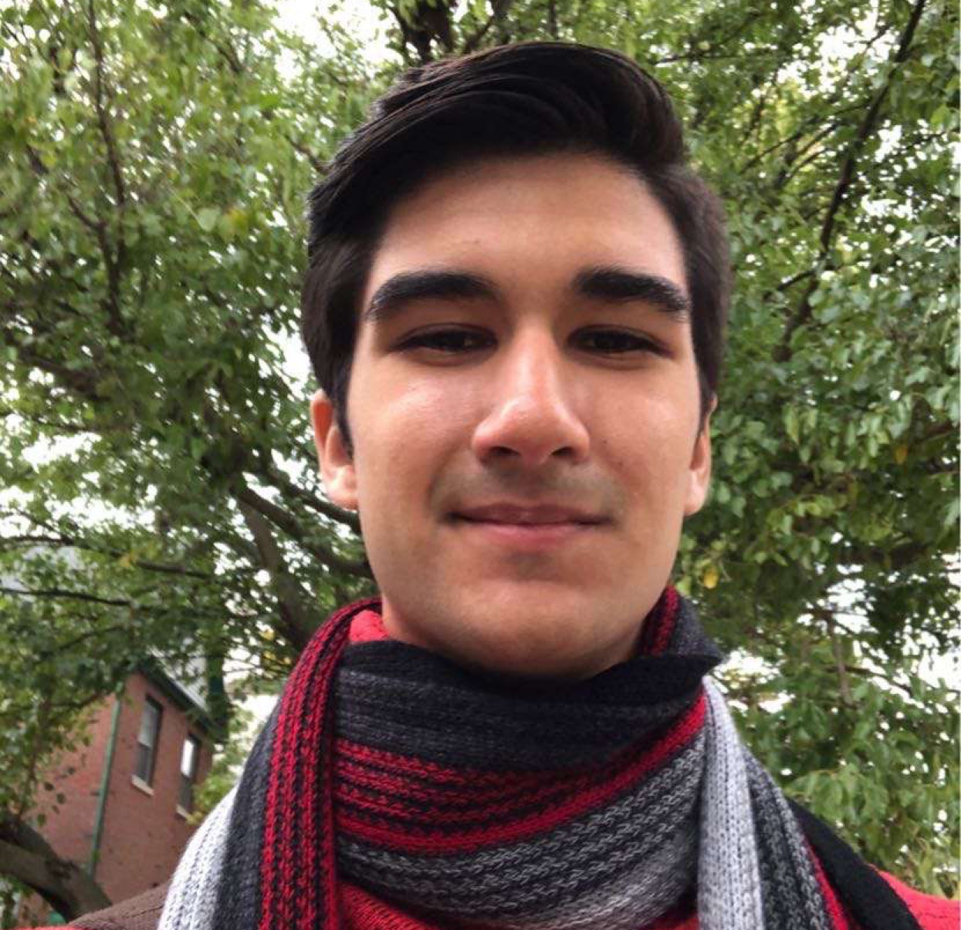
Your 9 newest besties in FSHN!
Gabby Pinto
President
Karson Hilgendorf
Vice President, Grad Recruitment Co-chair
Deven Madhani
Treasurer

Slide 3
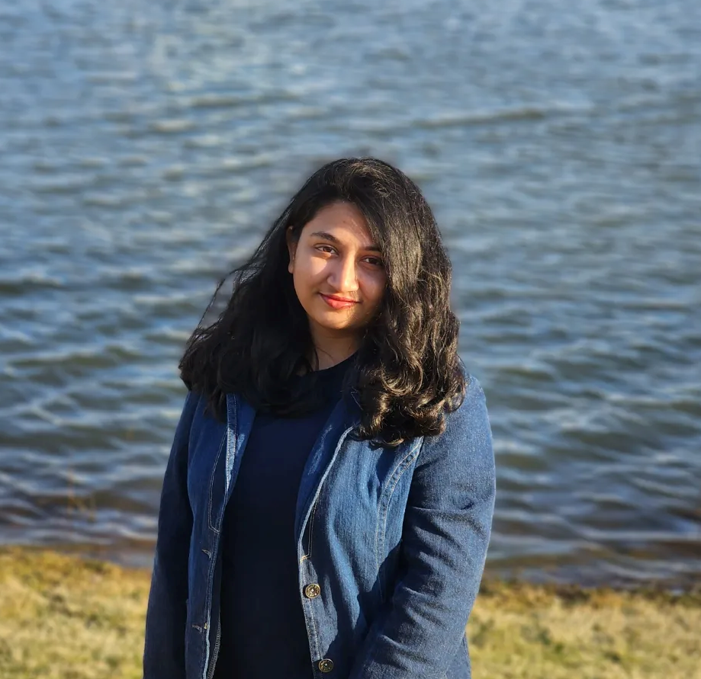
Your 9 newest besties in FSHN!
Jayita De
Secretary
Cecil Barnett-Neefs
Student Webmaster, Technical Chair
Suraya “Papri”
International Student Rep, Grad Recruitment Co-chair

Slide 4
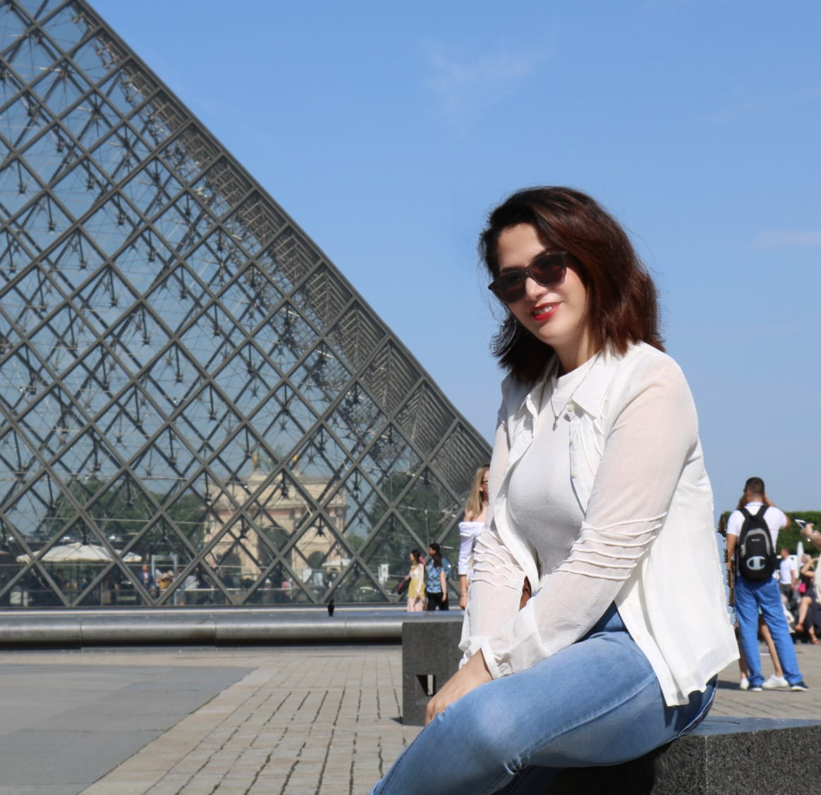
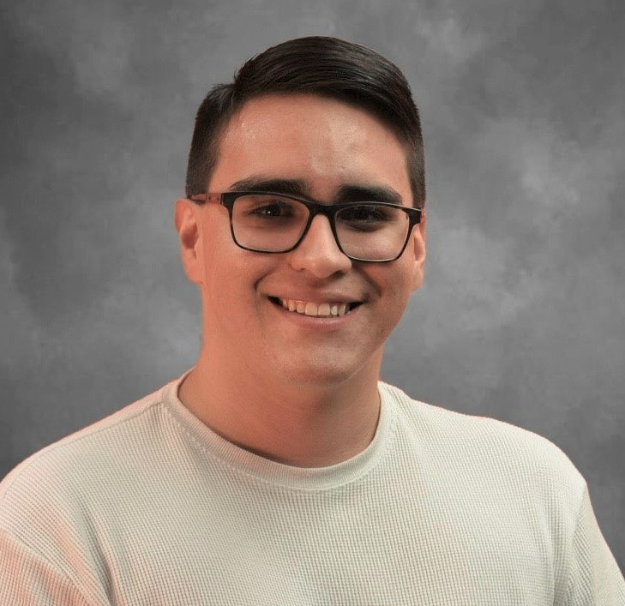
Your 9 newest besties in FSHN!
Mirai Miura
Social Activities Chair
Mehri Karbasi
Academic Activities Chair
Donald Molina
Social Media Rep

Slide 5
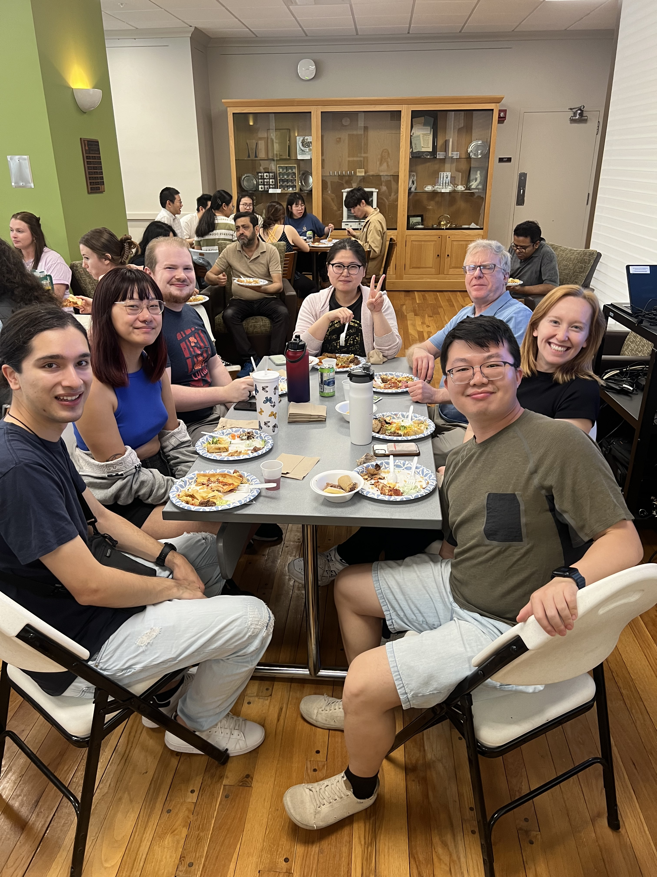
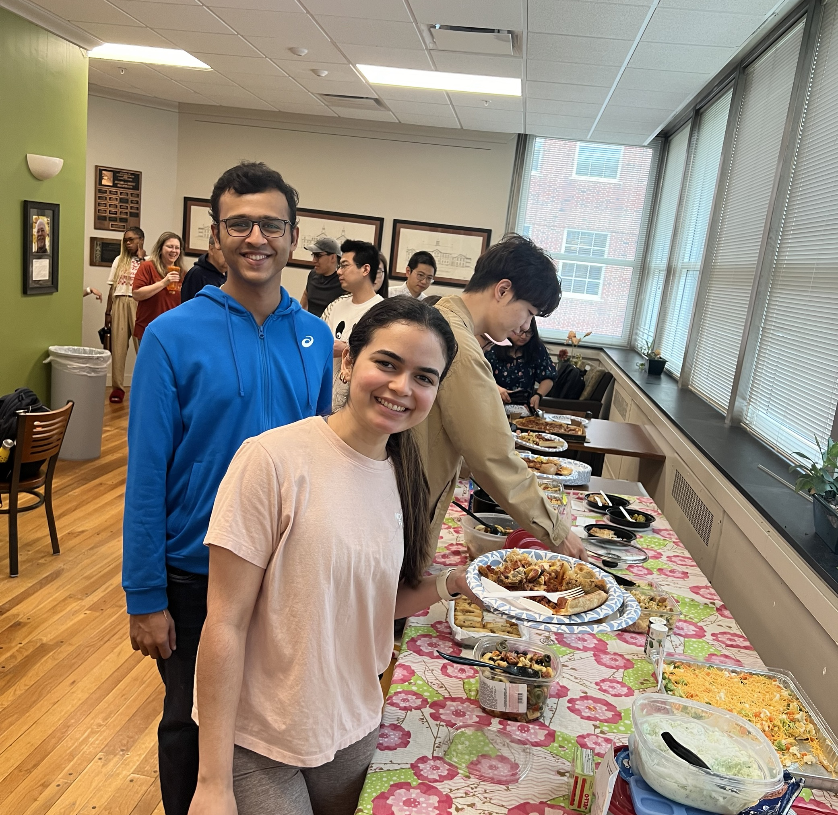
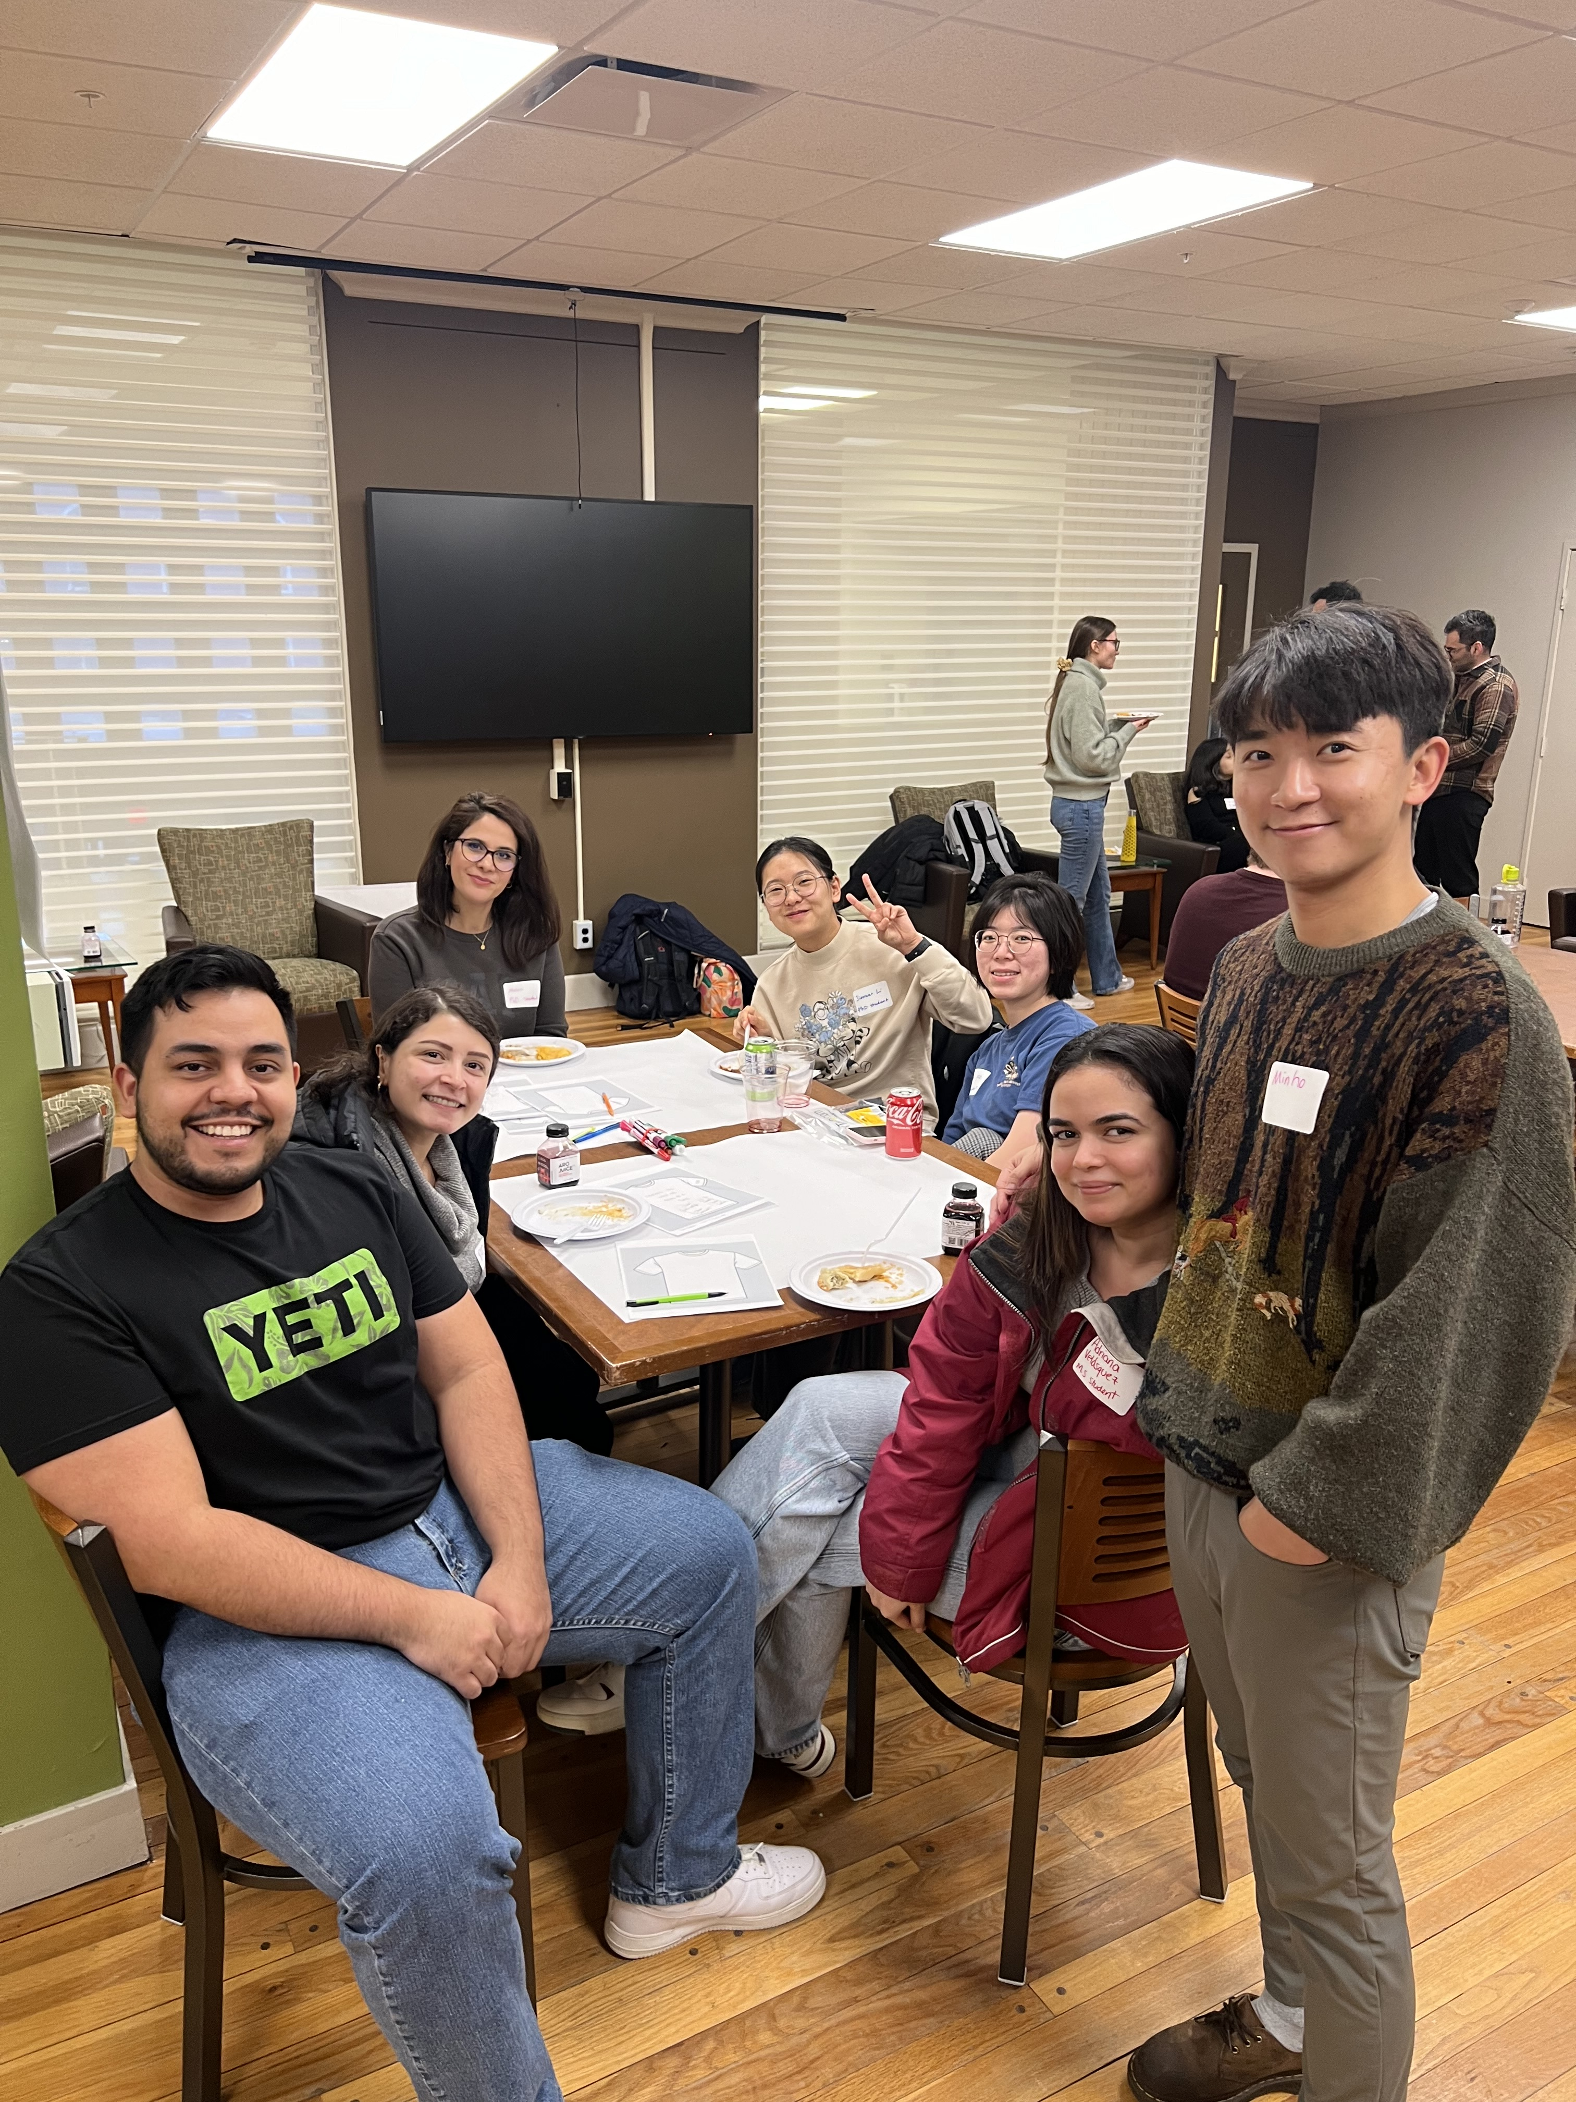
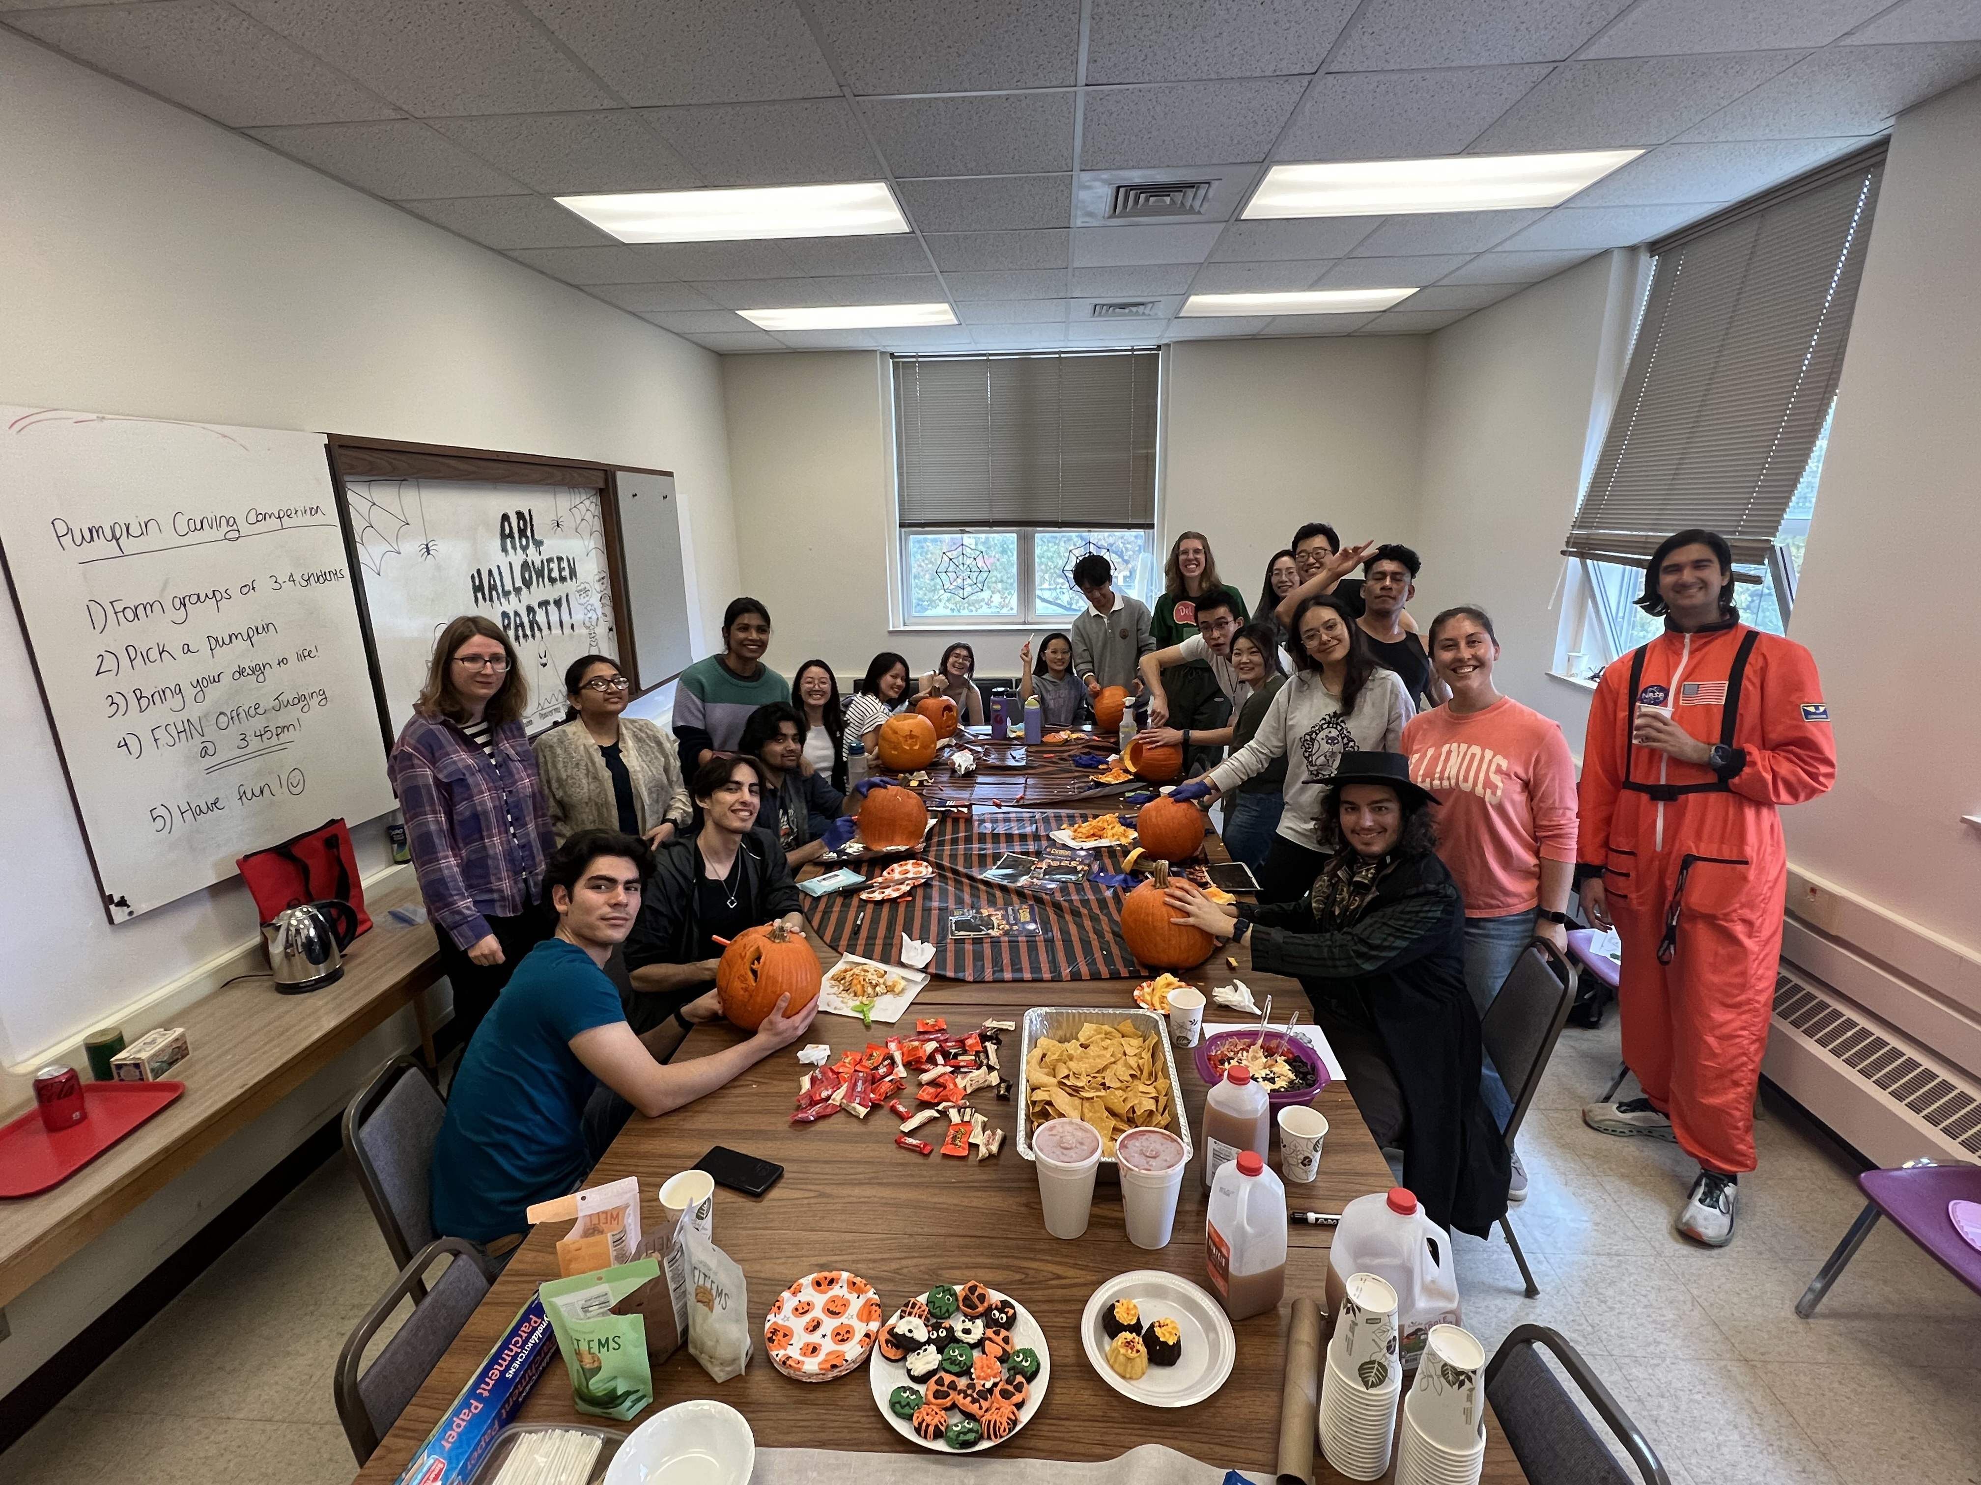
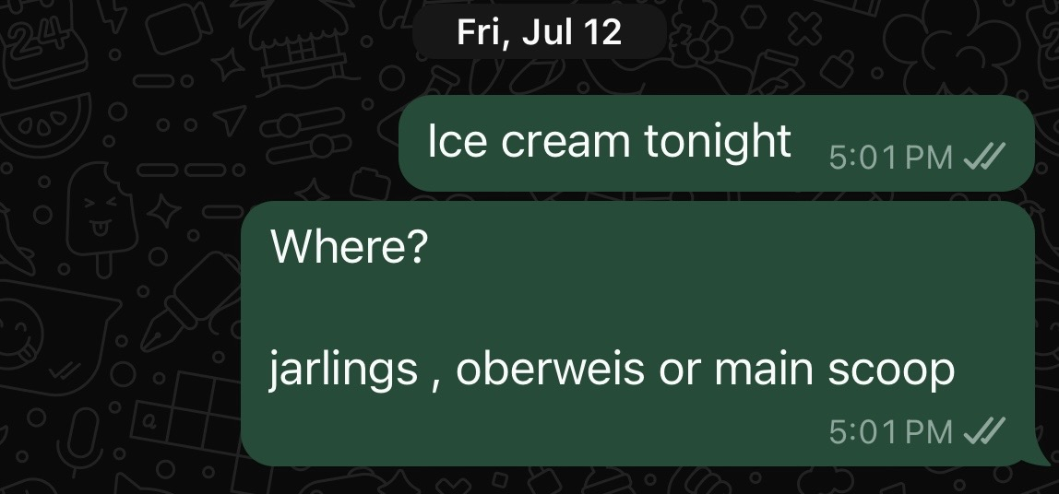
What can you expect from the FSHN GSA?
Fun events that often involve food!
Academic seminars (students practice for defense, new professors present)
Casual meet-ups (mental health walks, free ice skating, bowling, grabbing coffee or lunch, on-campus seminars with ~free~ food, etc.)
A community where we hope you feel comfortable asking us and other grad students questions! If you’re thinking it, someone else probably is too!

Slide 6
Fall 2024 Tentative Schedule
August 28th, 4-7 PM – Welcome Back BBQ & Potluck, Hessel Park Pavilion
September 3rd, 12-1 PM – Informal lunch with other College of ACES GSAs (Animal Sci, NRES), South Quad
September 5th, 11 AM-12 PM – “The Ins and Outs of the GEO” Seminar (snacks provided), Bevier Commons
September 9th – New event reveal!
TBD (September) – Pioneer Seminar Series #1
October 12th – College of ACES Tailgate “Celebrate Food & AG Day!”
TBD (October) – Pumpkin Carving Party/Competition
TBD (December) – Holiday Party/Cookie Decorating
And probably more!

Slide 7
How to stay connected:
Look out for emails!
Scan to join our group chat!
These will often come from Gabby, Karson, Audra, or Becca ☺
Specific questions?
Board contact info can be found at: https://gsa.fshn.illinois.edu/

